Slide 1
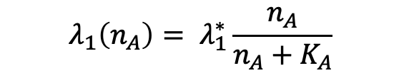
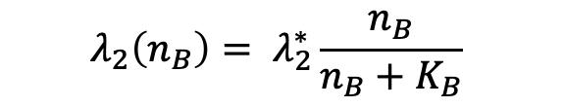
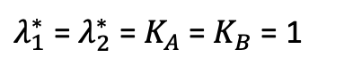
Engulfment Pattern
Nutrient A
$$λ_{1}\left(n_{A}\right)= λ_{1}^{∗}\frac{n_{A}}{n_{A}+K_{A}}$$
Cell Distribution
$λ_{1}^{∗}$ = $λ_{2}^{∗}$ = $K_{A}$ = $K_{B}$ = 1
$$λ_{2}\left(n_{B}\right)= λ_{2}^{∗}\frac{n_{B}}{n_{B}+K_{B}}$$
Nutrient B

Slide 2
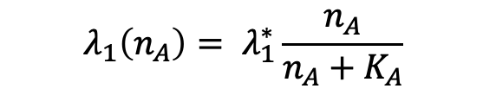
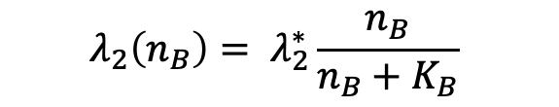
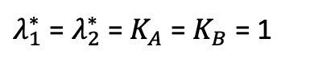
Spiral Pattern
$$λ_{2}\left(n_{B}\right)= λ_{2}^{∗}\frac{n_{B}}{n_{B}+K_{B}}$$
Nutrient B
Cell Distribution
$λ_{1}^{∗}$ = $λ_{2}^{∗}$ = $K_{A}$ = $K_{B}$ = 1
$$λ_{1}\left(n_{A}\right)= λ_{1}^{∗}\frac{n_{A}}{n_{A}+K_{A}}$$
Nutrient A

Slide 3
Spiral Analysis

Slide 4
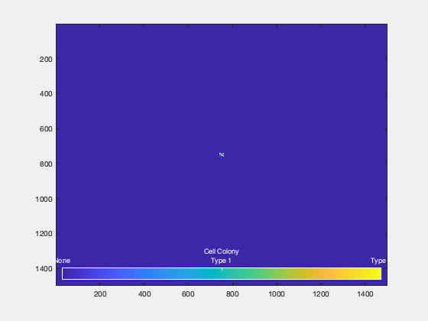


Random Initialized Condition Different growth rates
Growth rate = 0.5
Growth rate = 2
Growth rate = 5

Slide 5
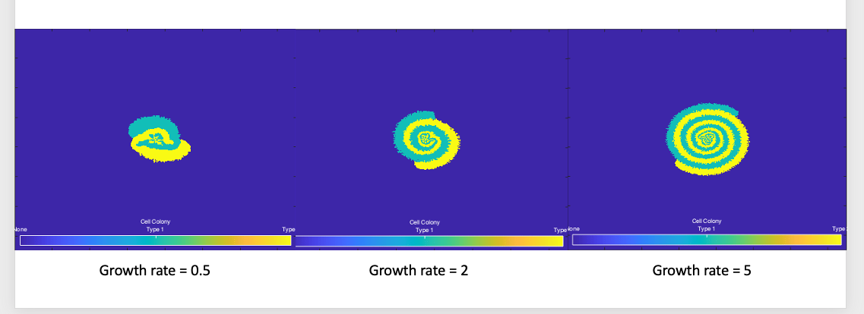
Random Initialized Condition Different growth rates

Slide 6
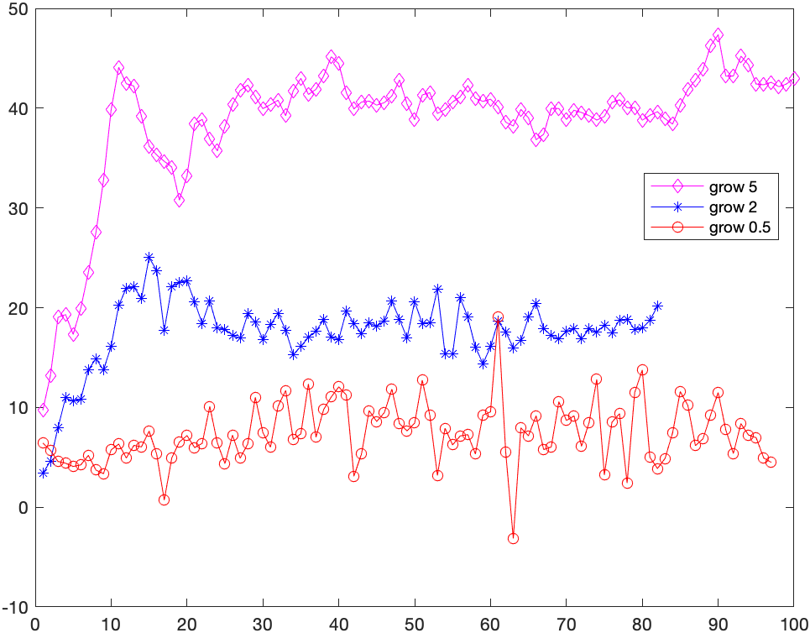
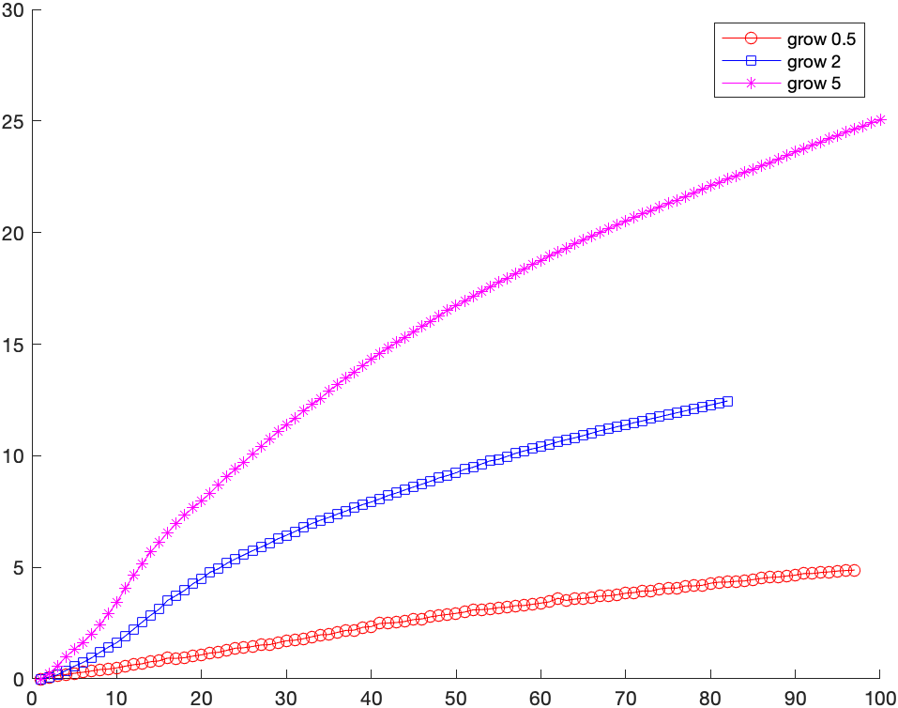
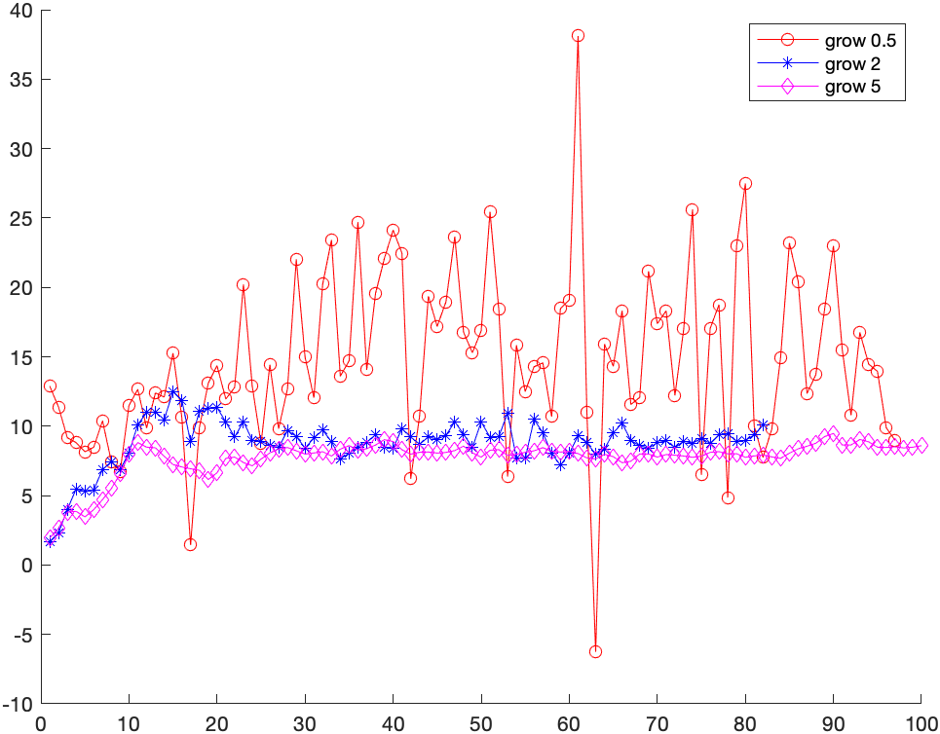
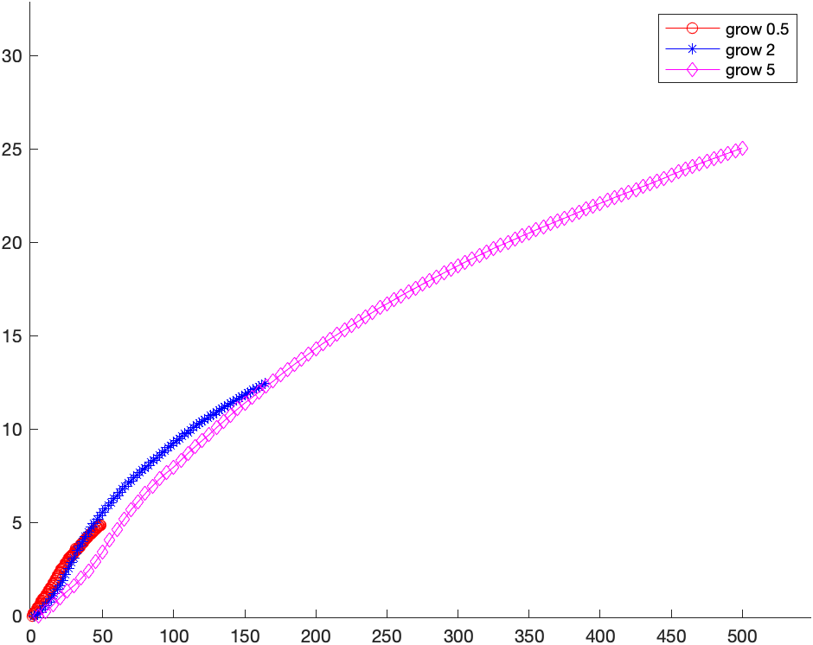
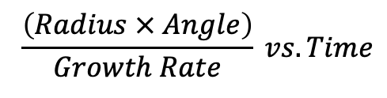
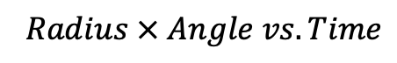
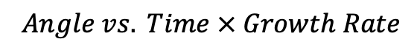
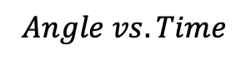
$$Radius × Angle vs. Time$$
$$Angle vs. Time$$
$$\frac{\left(Radius × Angle\right)}{Growth Rate} vs. Time$$
$$Angle vs. Time × Growth Rate$$

Slide 7
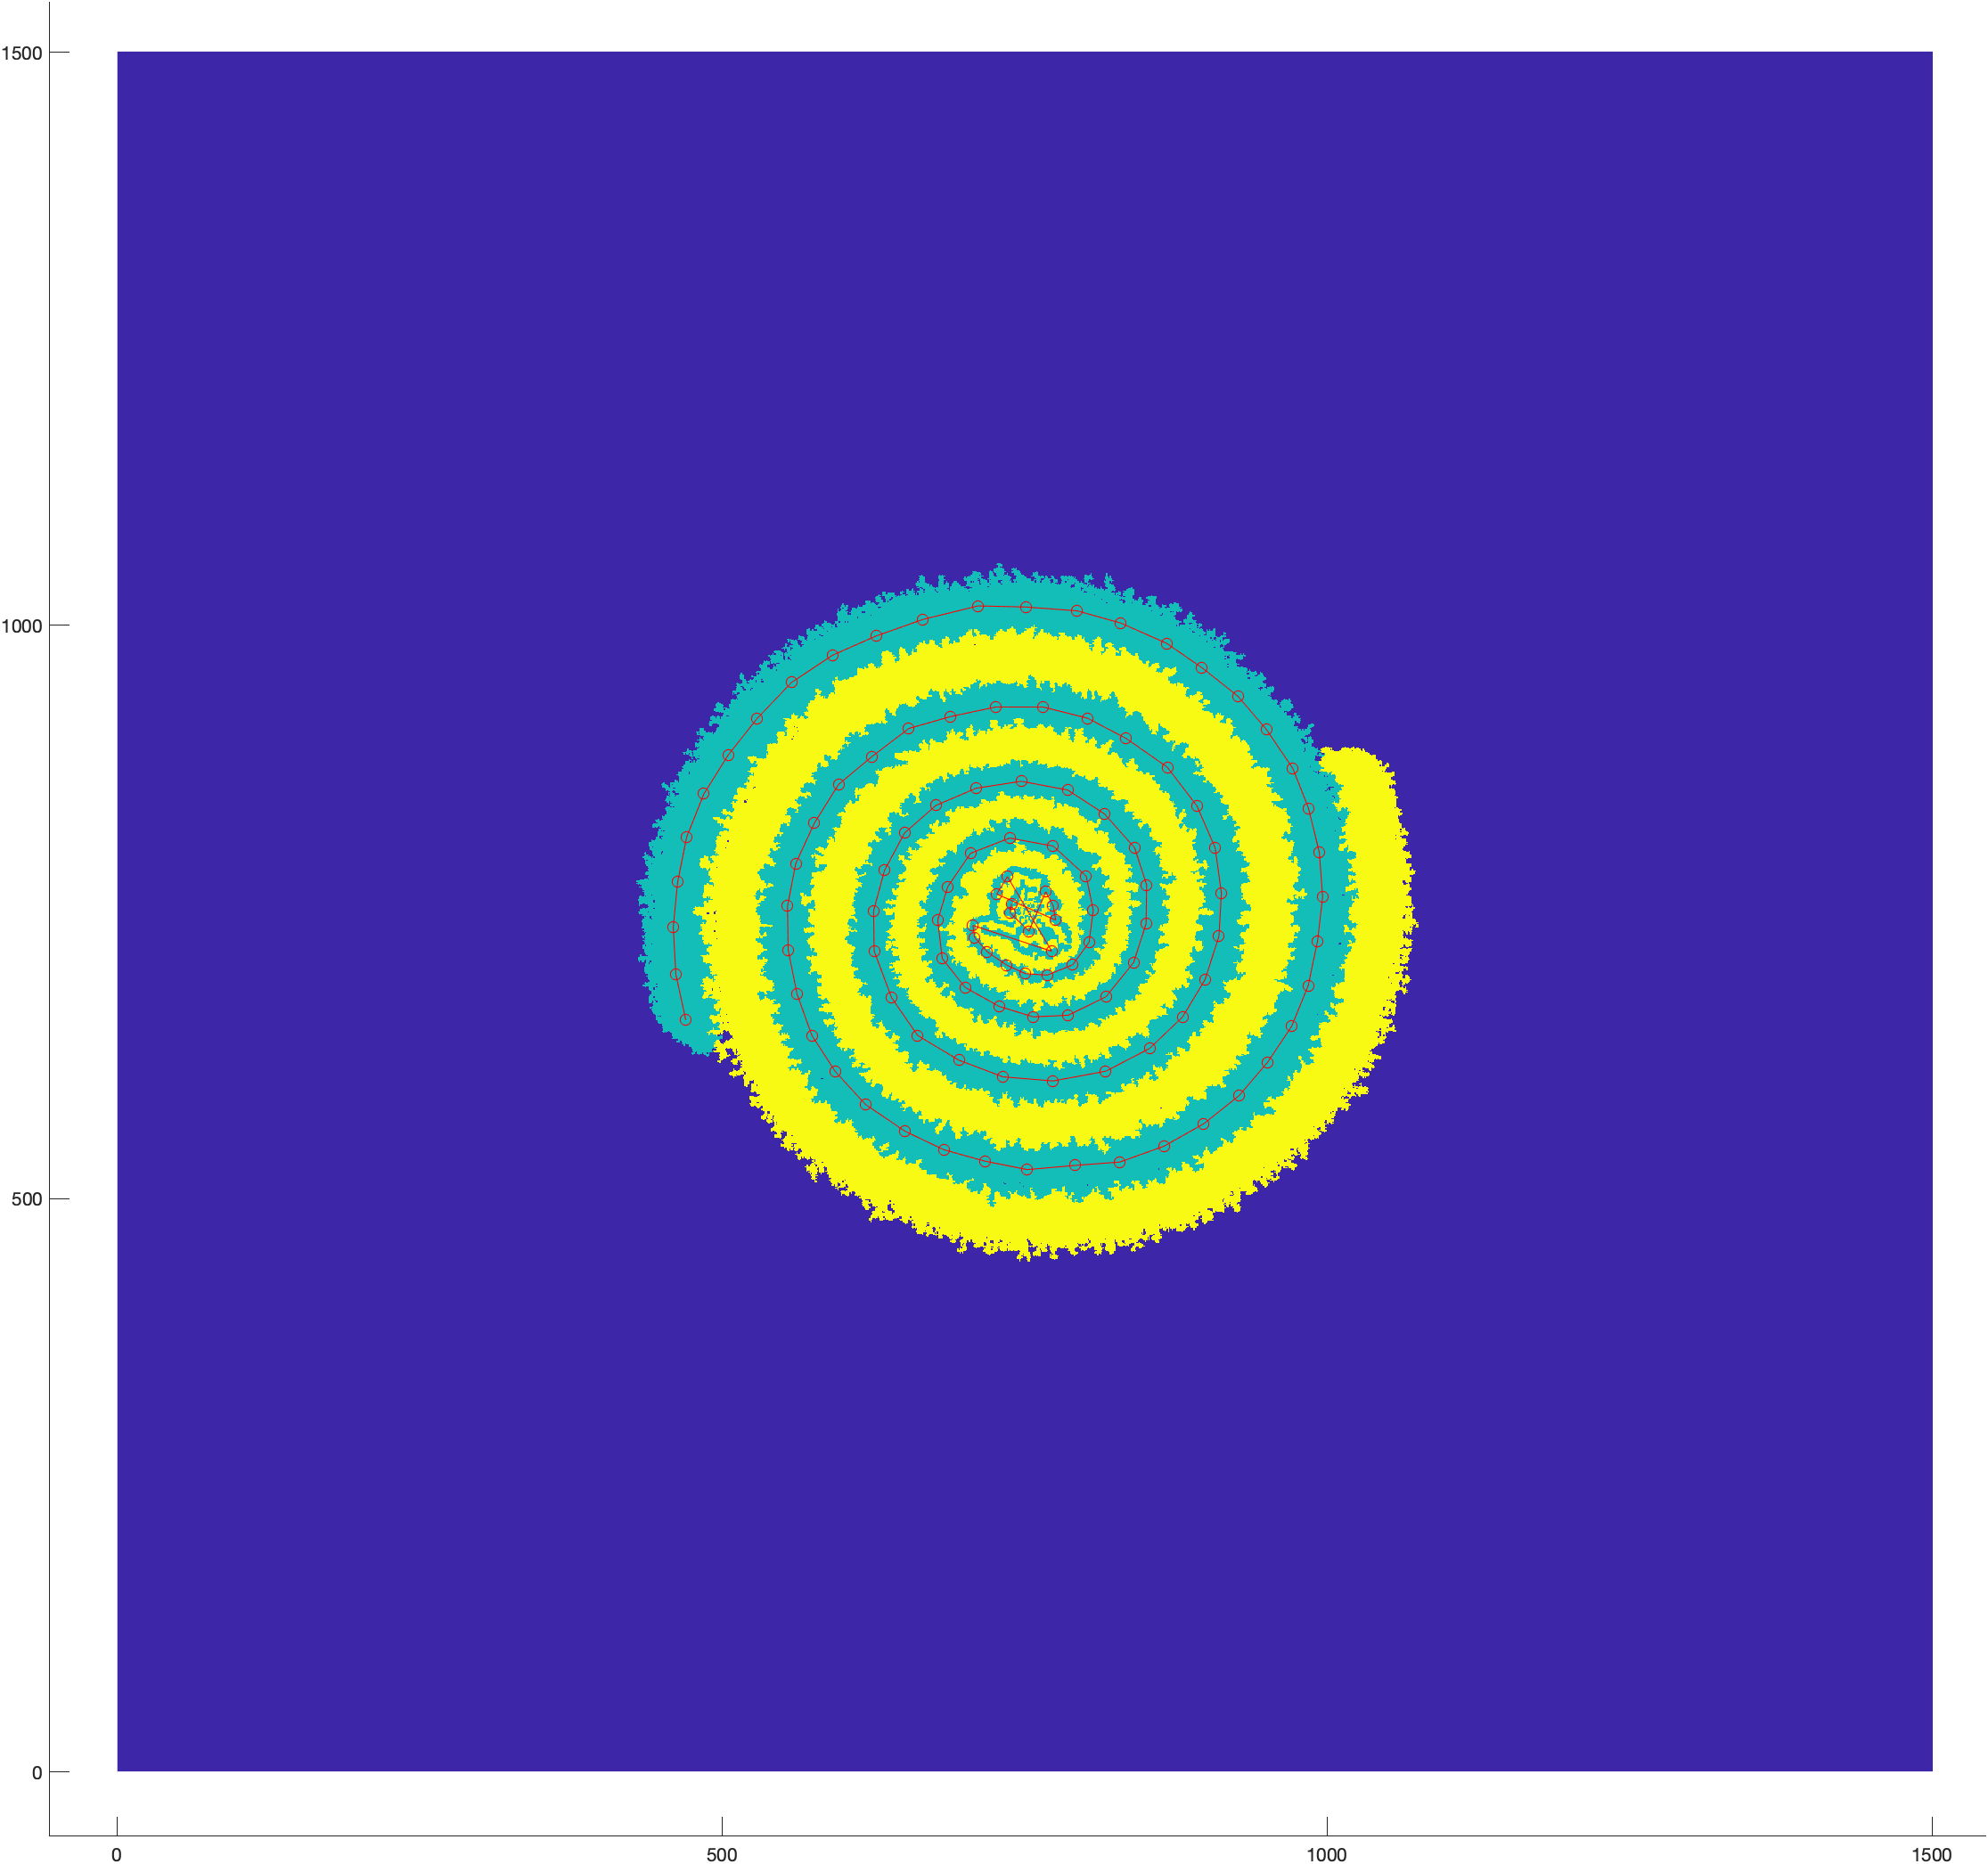
Steps in finding
change of angles of growth
Subtract two consecutive colonies
Find the largest cluster in the result matrix
Calculate the coordinate of the center of mass
Obtain the angle of the point

Slide 8

Growth rate = 2: Interesting 4-branch spiral

